Slide 1
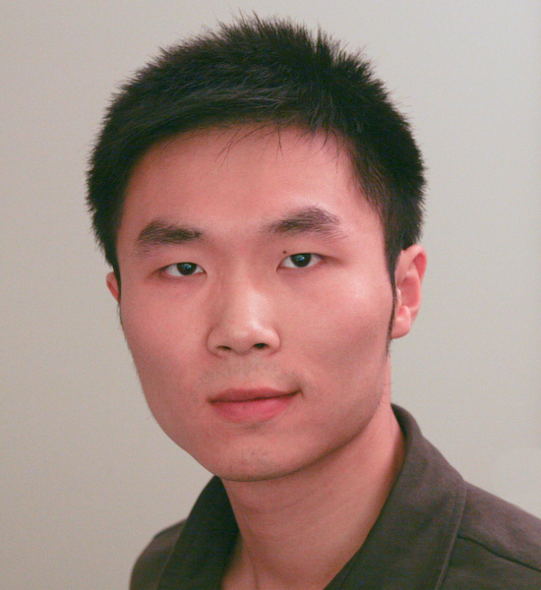
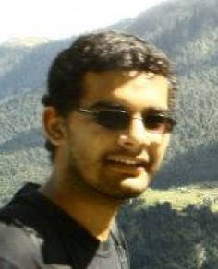
Large Scale Visual Recognition Challenge 2011
Alex Berg Stony Brook
Jia Deng Stanford & Princeton
Sanjeev Satheesh Stanford
Hao Su Stanford
Fei-Fei Li Stanford

Slide 2
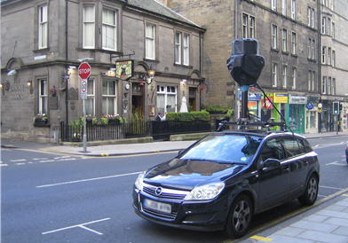
Large Scale Recognition
Millions to billions of images
Hundreds of thousands of possible labels
Recognition for indexing and retrieval
Complement current Pascal VOC competitions
LSVRC 2010
LSVRC 2011
Localization
Car
Car
Categorization
Car

Slide 3
Source for categories and training data
ImageNet
14,192,122 million images, 21841 thousand categories
Image found via web searches for WordNet noun synsets
Hand verified using Mechanical Turk
Bounding boxes for query object labeled
New data for validation and testing each year
WordNet
Source of the labels
Semantic hierarchy
Contains large fraction of English nouns
Also used to collect other datasets like tiny images (Torralba et al)
Note that categorization is not the end/only goal, so idiosyncrasies of WordNet may be less critical

Slide 4
ILSVRC 2011 Data
Training data
1,229,413 images in 1000 synsets
Min = 384 , median = 1300, max = 1300 (per synset)
315,525 images have bounding box annotations
Min = 100 / synset
345,685 bounding box annotations
Validation data
50 images / synset
55,388 bounding box annotations
Test data
100 images / synset
110,627 bounding box annotations
* Tree and some plant categories replaced with other objects between 2010,2011

Slide 5
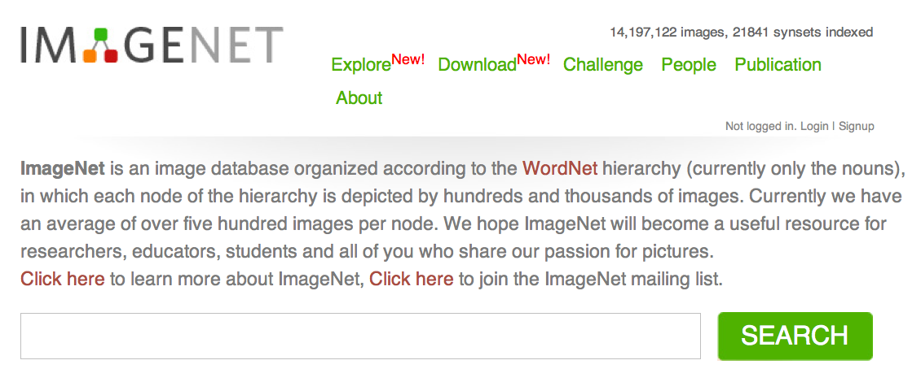
http://www.image-net.org
Jia Deng
(lead student)

Slide 6
is a knowledge ontology
Taxonomy
Partonomy
The “social network” of visual concepts
Hidden knowledge and structure among visual concepts
Prior knowledge
Context

Slide 7
is a knowledge ontology
Taxonomy
Partonomy
The “social network” of visual concepts
Hidden knowledge and structure among visual concepts
Prior knowledge
Context

Slide 8
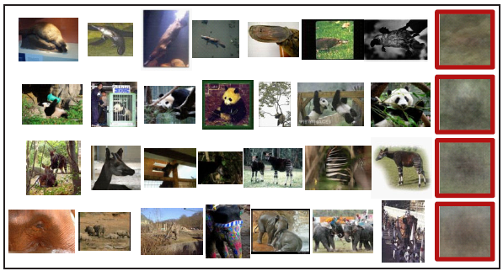
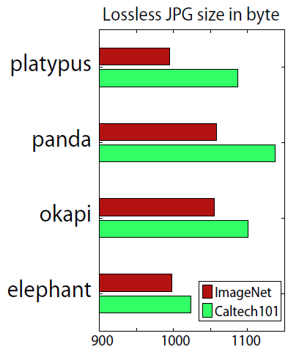
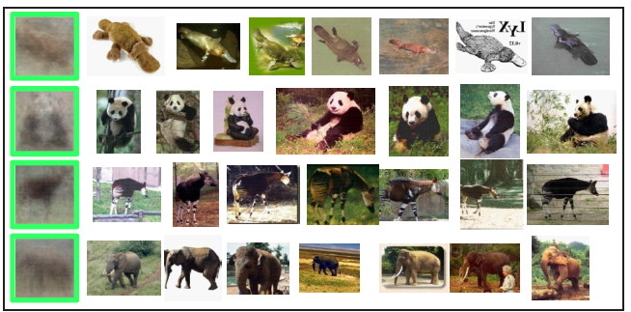
diversity
Diversity
Caltech101

Slide 9
Classification Challenge
Given an image predict categories of objects that may be present in the image
1000 “leaf” categories from ImageNet
Two evaluation criteria based on cost averaged over test images
Flat cost – pay 0 for correct category, 1 otherwise
Hierarchical cost – pay 0 for correct category, height of least common ancestor in WordNet for any other category (divide by max height for normalization)
Allow a shortlist of up to 5 predictions
Use the lowest cost prediction each test image
Allows for incomplete labeling of all categories in an image

Slide 10
Participation
96 registrations
15 submissions
Top Entries
Xerox Research Centre Europe
Univ. Amsterdam & Univ. Trento
ISI Lab Univ. Tokyo
NII Japan

Slide 11
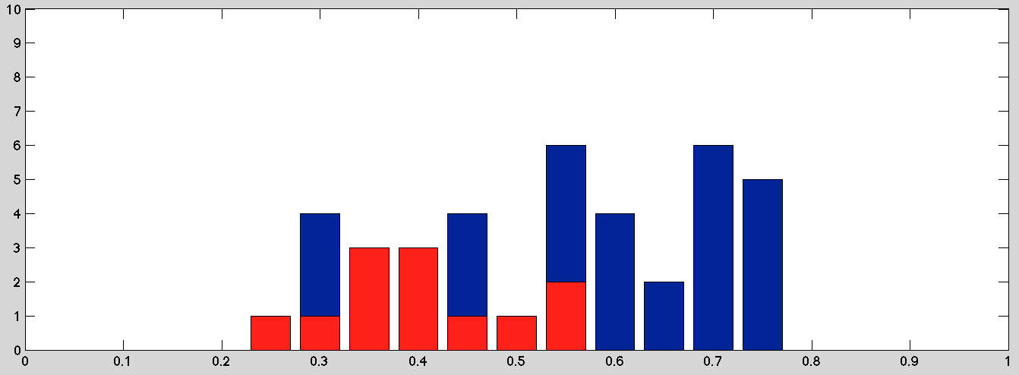
Classification Results Flat Cost, 5 Predictions per Image
2011
0.26
2010
0.28
Baseline
0.80
# Entries
Flat Cost
Probably evidence of some self selection in submissions.

Slide 12
Best Classification Results 5 Predictions / Image

Slide 13
Classification Winners
XRCE ( 0.26 )
Univ. Amsterdam & Univ. Trento ( 0.31 )
ISI Lab Tokyo University ( 0.34 )

Slide 14
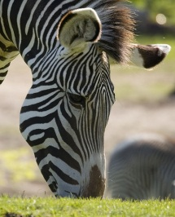
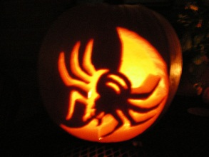
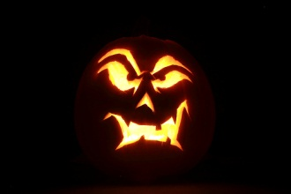
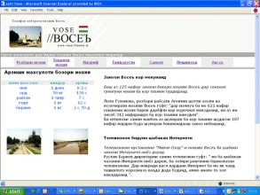
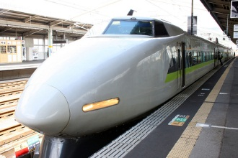
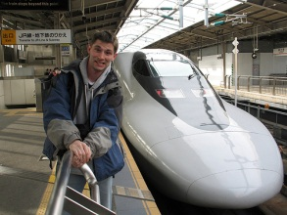
Easiest synsets
web site, website, internet site, site | 0.067
jack-o'-lantern | 0.117
odometer, hodometer, | 0.127
manhole cover | 0.127
bullet train, bullet | 0.147
electric locomotive | 0.150
zebra | 0.163
daisy | 0.170
pickelhaube | 0.170
freight car | 0.180
nematode, nematode worm, roundworm | 0.180
* Numbers indicate the mean flat cost from the top 5 predictions from all submissions

Slide 15
Toughest Synsets
water jug | 0.940
cassette player | 0.940
weasel | 0.943
sunscreen, sunblock, sun blocker | 0.943
plunger, plumber's helper | 0.947
syringe | 0.950
wooden spoon | 0.953
mallet | 0.957
spatula | 0.963
paintbrush | 0.967
power drill | 0.973
* Numbers indicate the mean flat cost from the top 5 predictions from all submissions

Slide 16
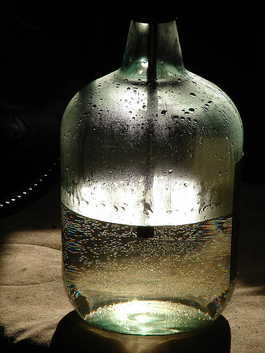
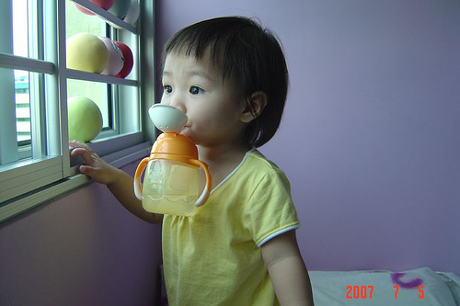
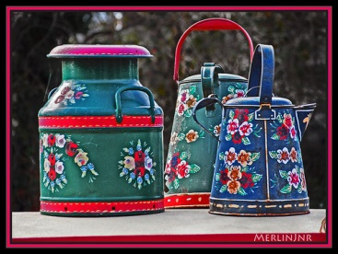
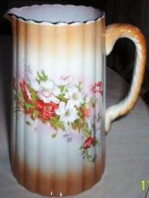
Water-jugs are hard!

Slide 17
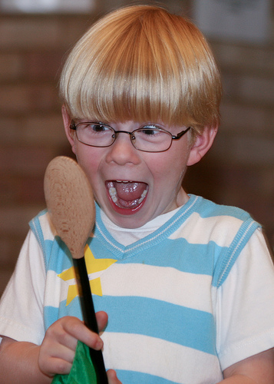
But wooden spoons?

Slide 18
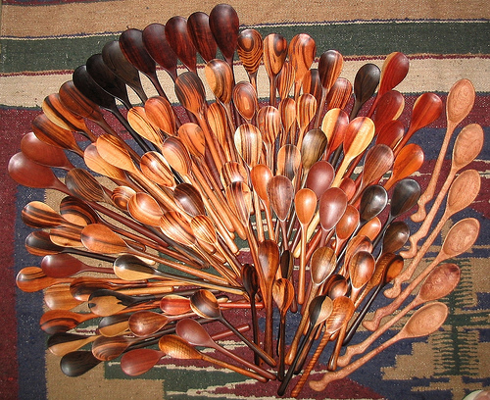
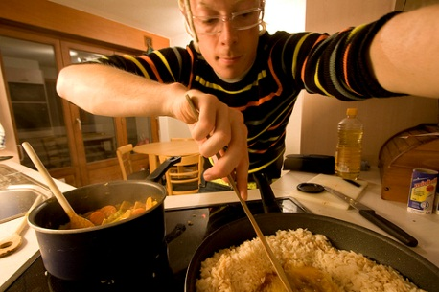
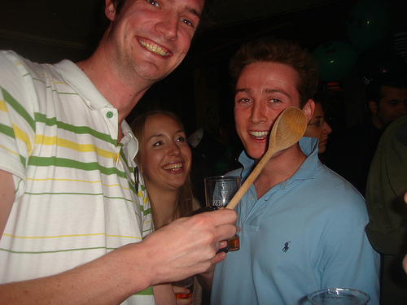
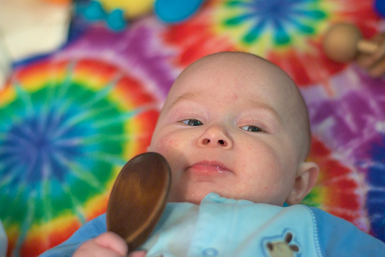
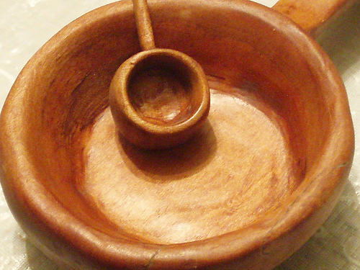

Slide 19
Easiest Subtrees
Synset | # of leaves | Average flat cost
furniture, piece of furniture | 32 | 0.4563
vehicle | 65 | 0.4728
bird | 64 | 0.5092
food | 21 | 0.5362
vertebrate, craniate | 256 | 0.5804

Slide 20
Hardest Subtrees
Synset | # of leaves | Average flat cost
implement | 55 | 0.7285
tool | 27 | 0.7126
vessel | 24 | 0.6875
reptile | 36 | 0.6650
dog | 31 | 0.6277

Slide 21
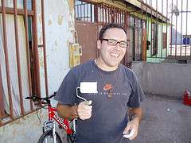
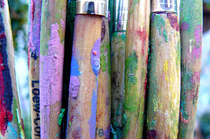
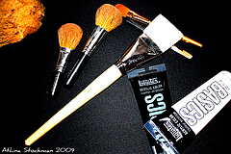
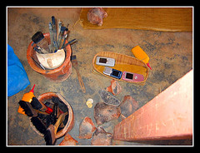
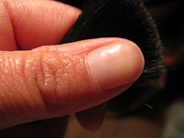
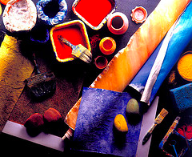
Most difficult …..?

Slide 22
Most difficult paintbrushes!

Slide 23
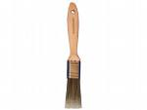
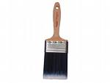
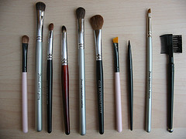
Easiest paintbrushes

Slide 24
Localization Challenge

Slide 25
Entries
Two Brave Submissions
Team | Flat cost | Hierarchical cost
University of Amsterdam & University of Trento | 0.425 | 0.285
ISI lab., the Univ. of Tokyo | 0.565 | 0.41

Slide 26
Precision
Best | Worst
jack-o'-lantern | paintbrush
web site, website, internet site, site | muzzle
monarch, monarch butterfly, | power drill
rock beauty [tricolored fish] | water jug
golf ball | mallet
daisy | spatula
airliner | gravel, crushed rock

Slide 27
Recall
Best | Worst
jack-o'-lantern | paintbrush
web site, website, internet site, site | muzzle
monarch, monarch butterfly, | power drill
rock beauty [tricolored fish] | water jug
golf ball | mallet
manhole cover | spatula
airliner | gravel, crushed rock

Slide 28
Rough Analysis
Detection performance coupled to classification
All of {paintbrush, muzzle, power drill, water jug, mallet, spatula ,gravel} and many others are difficult classification synsets
The best detection synsets those with the best classification performance
E.g., Tend to occupy the entire image

Slide 29
Highly accurate localizations from the winning submission

Slide 30
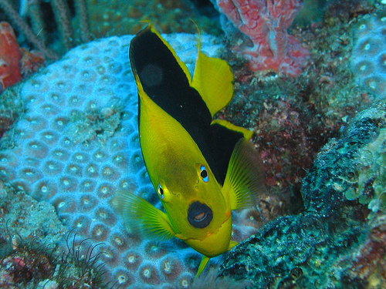
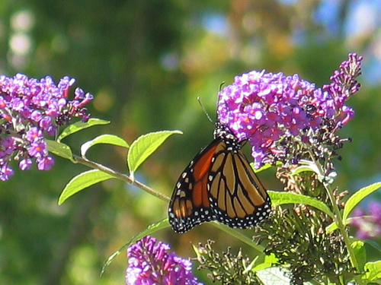
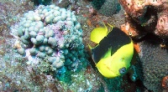
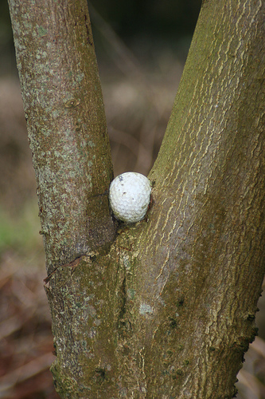
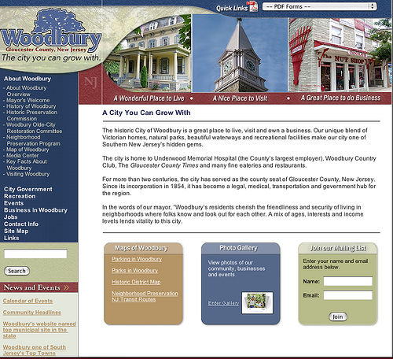
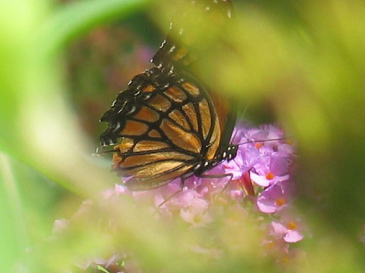

Slide 31
Other correct localizations from the winning submission

Slide 32
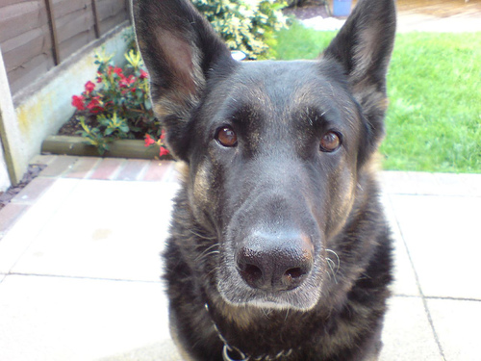
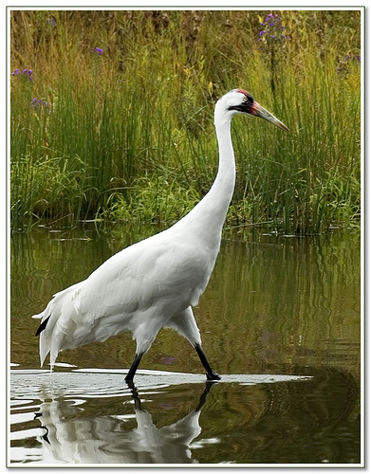
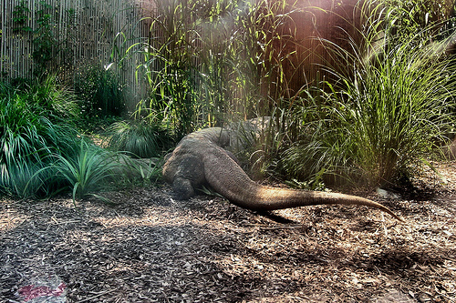
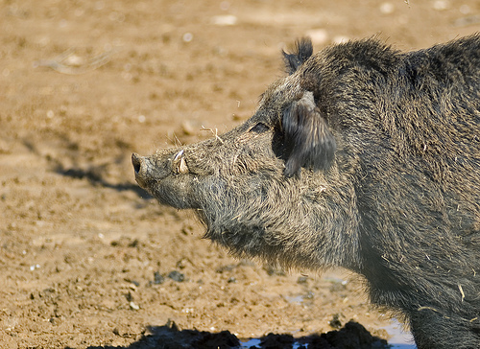
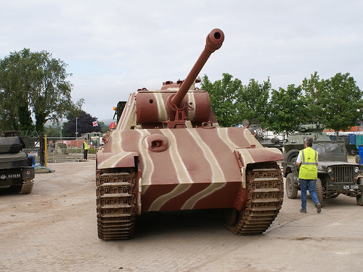
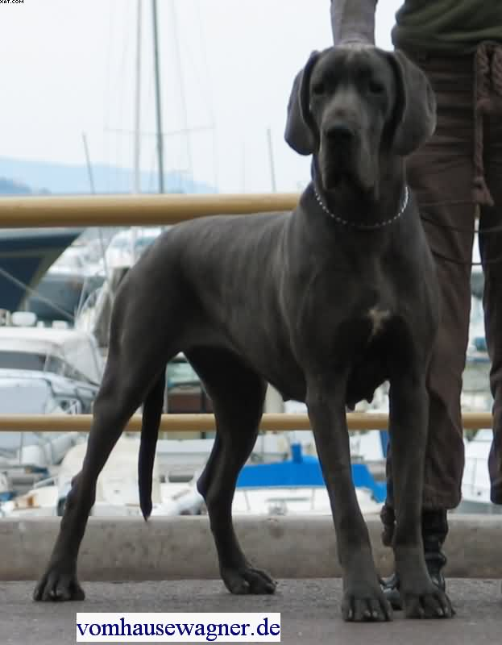
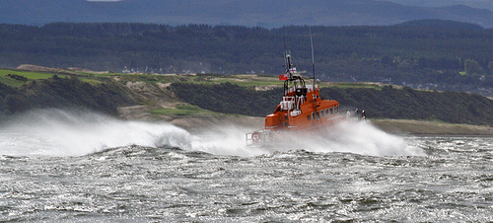

Slide 33
2012 Large Scale Visual Recognition Challenge!
Stay tuned…

